Slide 1
Chemical Changes
By Soko, Cristian, and Devaughn

Slide 2
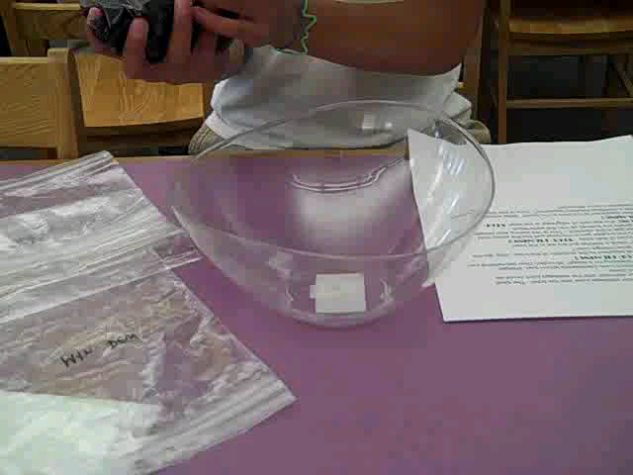
This video will show you the first steps before heartburn occurs. The ingredients we pour in could be anything you ate or drank.

Slide 3
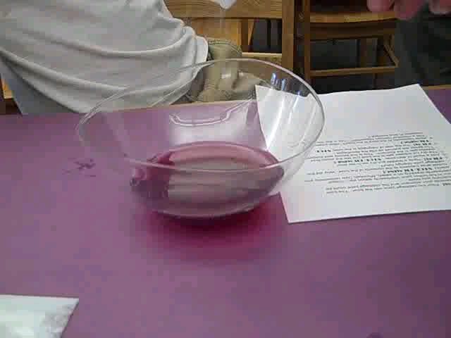
In this video it will show a Chemical Change because the color will change. Also the dry ice will react when it touches the chemicals this happens when a heartburn starts. It will go surging up to your esophagus.

Slide 4
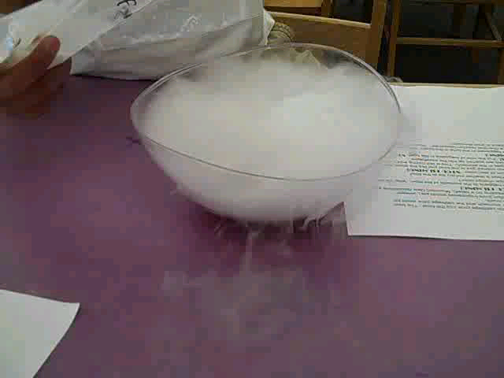
When we pour in the milk of magnesia our experiment is supposed to slowly go back to its normal color. The milk of magnesia brings down the chemicals back down from your esophagus to your stomach.

Slide 5
Our Parts
Devaughn mcCoy was the experiment person,
Soko Brown was the narrator and director,
Cristian Ramos was the filmier.

Slide 6
Bibliography
Stomach Chemistry. (2002, November 4). Retrieved September 13, 2010, from Utah Education Network: http://www.uen.org/Lessonplan/preview?LPid=2689

